Slide 1
ECE 250 Algorithms and Data Structures
Abstract Priority Queues
Douglas Wilhelm Harder, M.Math. LEL
Department of Electrical and Computer Engineering
University of Waterloo
Waterloo, Ontario, Canada
ece.uwaterloo.ca
dwharder@alumni.uwaterloo.ca
© 2006-2013 by Douglas Wilhelm Harder. Some rights reserved.

Slide 2
Outline
This topic will:
Review queues
Discuss the concept of priority and priority queues
Look at two simple implementations:
Arrays of queues
AVL trees
Introduce heaps, an alternative tree structure which has better run-time characteristics

Slide 3
Background
7.1
We have discussed Abstract Lists with explicit linear orders
Arrays, linked lists, strings
We saw three cases which restricted the operations:
Stacks, queues, deques
Following this, we looked at search trees for storing implicit linear orders: Abstract Sorted Lists
Run times were generally Θ(ln(n))
We will now look at a restriction on an implicit linear ordering:
Priority queues

Slide 4
Definition
7.1.1
With queues
The order may be summarized by first in, first out
If each object is associated with a priority, we may wish to pop that object which has highest priority
With each pushed object, we will associate a nonnegative integer (0, 1, 2, ...) where:
The value 0 has the highest priority, and
The higher the number, the lower the priority

Slide 5
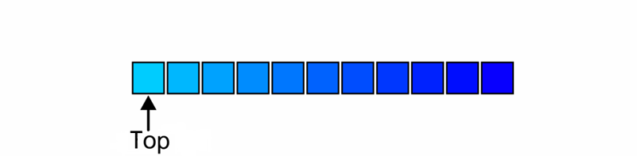
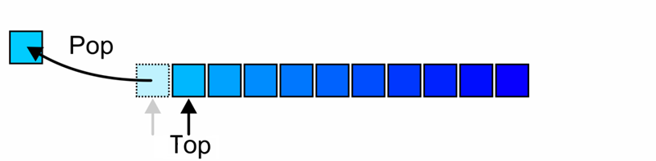
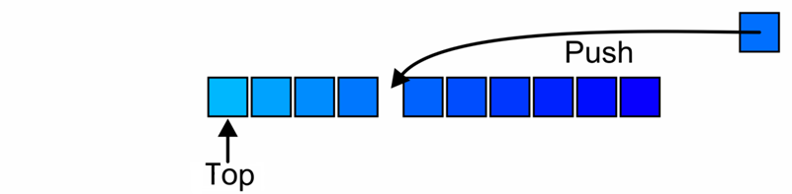
Operations
7.1.2
The top of a priority queue is the object with highest priority
Popping from a priority queue removes the current highest priority object:
Push places a new object into the appropriate place

Slide 6
Lexicographical Priority
7.1.3
Priority may also depend on multiple variables:
Two values specify a priority: (a, b)
A pair (a, b) has higher priority than (c, d) if:
a < c, or
a = c and b < d
For example,
(5, 19), (13, 1), (13, 24), and (15, 0) all have higher priority than (15, 7)

Slide 7
Process Priority in Unix
7.1.4
This is the scheme used by Unix, e.g.,
% nice +15 ./a.out
reduces the priority of the execution of the routine a.out by 15
This allows the processor to be used by interactive programs
This does not significantly affect the run-time of CPU-bound processes

Slide 8
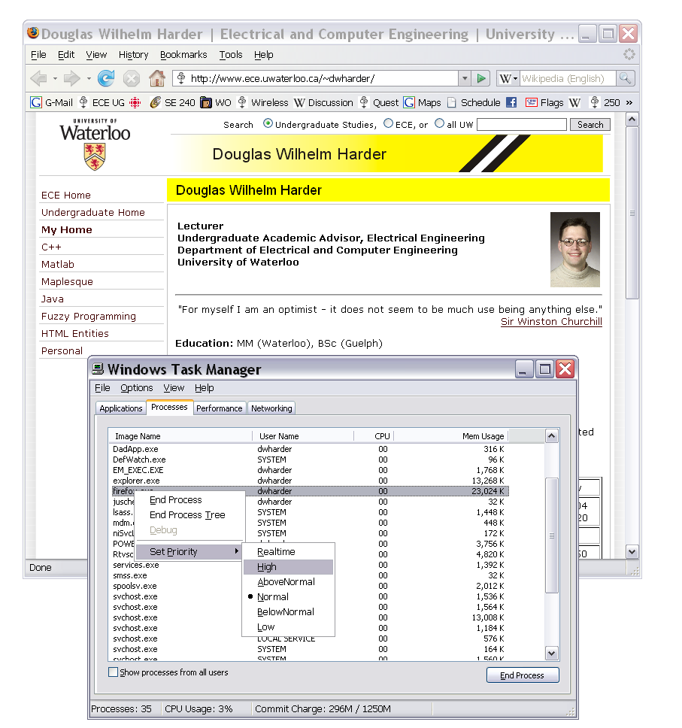
Process Priority in Windows
7.1.4
The priority of processes in Windows may be set in the Windows Task Manager

Slide 9
Implementations
7.1.5
Our goal is to make the run time of each operation as close to Θ(1) as possible
We will look at two implementations using data structures we already know:
Multiple queues—one for each priority
An AVL tree
The next topic will be a more appropriate data structure: the heap

Slide 10
Multiple Queues
7.1.5.1
Assume there is a fixed number of priorities, say M
Create an array of M queues
Push a new object onto the queue corresponding to the priority
Top and pop find the first empty queue with highest priority
Notes:
10

Slide 11
Multiple Queues
7.1.5.1
template <typename Type, int M>
class Multiqueue {
private:
queue<Type> queue_array[M];
int queue_size;
public:
Multiqueue();
bool empty() const;
Type top() const;
void push( Type const &, int );
Type pop();
};
template <typename Type, int M>
Multiqueue<Type>::Multiqueue():
queue_size( 0 ) {
// The compiler allocates memory for the M queues
// and calls the constructor on each of them
}
template <typename Type, int M>
bool Multiqueue<Type>::empty() const{
return ( queue_size == 0 );
}

Slide 12
Multiple Queues
7.1.5.1
template <typename Type, int M>
void Multiqueue<Type>::push( Type const &obj, int pri ) {
if ( pri < 0 || pri >= M ) {
throw illegal_argument();
}
queue_array[pri].push( obj );
++queue_size;
}
template <typename Type, int M>
Type Multiqueue<Type>::top() const {
for ( int pri = 0; pri < M; ++pri ) {
if ( !queue_array[pri].empty() ) {
return queue_array[pri].front();
}
}
// The priority queue is empty
throw underflow();
}
template <typename Type, int M>
Type Multiqueue<Type>::pop() {
for ( int pri = 0; pri < M; ++pri ) {
if ( !queue_array[pri].empty() ) {
--queue_size;
return queue_array[pri].pop();
}
}
// The priority queue is empty
throw underflow();
}

Slide 13
Multiple Queues
7.1.5.1
The run times are reasonable:
Push is Θ(1)
Top and pop are both O(M)
Unfortunately:
It restricts the range of priorities
The memory requirement is Θ(M + n)

Slide 14
AVL Trees
7.1.5.2
We could simply insert the objects into an AVL tree where the order is given by the stated priority:
Insertion is Θ(ln(n)) void insert( Type const & );
Top is Θ(ln(n)) Type front();
Remove is Θ(ln(n)) bool remove( front() );
There is significant overhead for maintaining both the tree and the corresponding balance

Slide 15
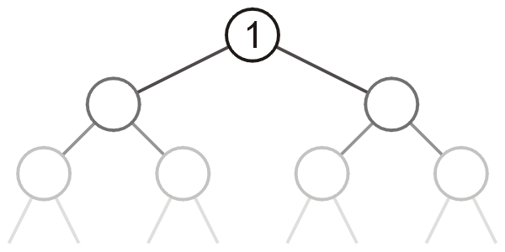
Heaps
7.1.5.3
Can we do better?
That is, can we reduce some (or all) of the operations down to Θ(1)?
The next topic defines a heap
A tree with the top object at the root
We will look at binary heaps
Numerous other heaps exists:
d-ary heaps
Leftist heaps
Skew heaps
Binomial heaps
Fibonacci heaps
Bi-parental heaps

Slide 16
Summary
This topic:
Introduced priority queues
Considered two obvious implementations:
Arrays of queues
AVL trees
Discussed the run times and claimed that a variation of a tree, a heap, can do better
Notes:
16

Slide 17
References
Cormen, Leiserson, Rivest and Stein, Introduction to Algorithms, The MIT Press, 2001, §6.5, pp.138-44.
Mark A. Weiss, Data Structures and Algorithm Analysis in C++, 3rd Ed., Addison Wesley, 2006, Ch.6, p.213.
Joh Kleinberg and Eva Tardos,
Algorithm Design, Pearson, 2006, §2.5, pp.57-65.
Elliot B. Koffman and Paul A.T. Wolfgang,
Objects, Abstractions, Data Structures and Design using C++, Wiley, 2006, §8.5, pp.489-96
These slides are provided for the ECE 250 Algorithms and Data Structures course. The material in it reflects Douglas W. Harder’s best judgment in light of the information available to him at the time of preparation. Any reliance on these course slides by any party for any other purpose are the responsibility of such parties. Douglas W. Harder accepts no responsibility for damages, if any, suffered by any party as a result of decisions made or actions based on these course slides for any other purpose than that for which it was intended.

